Slide 1
Combating Negative Population Growth in Illinois -
Text Analysis on News Articles
Natural Language Processing & Cognitive Computing
Targoon Siripanichpong

Slide 2
Executive Summary & Methodology
Executive Summary
Objectives - Identify reasons for IL population decline & suggest potential actions to the state of Illinois to reduce decline
Dataset - 30 days of news articles related to Illinois were collected and filtered using multiple methods to eliminate irrelevant articles
Analysis & Techniques
Topic Modeling - Provides a high-level overview of different topics of the news articles
Sentiment Analysis - Implemented with a custom lexicon. Analyzes sentiments for the relevant news articles to provide insights
Named Entity Recognition - Targets people and organizations for more specific sentiment analysis
Observations
Negative Sentiments - taxation, law enforcement, crime/violence
Positive Sentiments - clean energy, healthcare, recreational policies
Recommendations
Consider population growth when making decisions on law & regulation changes, especially around taxation, recreational policies, and healthcare.
Promote clean energy consumption and production (e.g., tax credit/deduction for business/residents, subsidies for businesses in the clean energy sector).
Methodology Overview
01
Text Preprocessing
Text Tokenization
Stopword & Punctuation Removal (with custom dictionary)
Lemmatization & Singularization
02
Article Cleanup/Filtering & Topic Modeling
Removing duplicate articles with SimHash
Filtering out articles that are irrelevant based on topics from Topic Modeling & human-defined topics
Re-performing Topic Modeling to obtain post-filtered topics
03
Sentiment Analysis
Leveraging Vader Sentiment Analysis library to initiate original sentiment score articles related to Illinois residents & businesses
Customizing the Vader lexicon based on manual label inspections
04
Targeted Sentiment Analysis
Identifying entities (people & businesses) using Named Entity Recognition
Predicting targeted sentiments on articles specific to people or businesses

Slide 3
Text Preprocessing -
News Article Cleanup/Filtering
Text Preprocessing
Near-Duplicate Articles Removal
Filtering via Topic Modeling
Additional Article Filtering
Keyword-based Article FIltering
Perform text tokenization, extended stopword removal, lemmatization, and singularization
Use SimHash algorithm to filter out near- duplicate articles
Perform LDA to cluster news into different topics. Identify topics that are irrelevant to analysis (e.g. Job Postings, Home Sales & Rentals). Filter out these topics.
Remove articles with very high/low word counts in the titles
Remove articles related to sports, weather, TV shows & movies, job postings, sales & promotions, and one-time occurrence news. Keywords are being used in this instance, as topic modeling was not able to extract these topics explicitly.
1
2
3
4
5

Slide 4
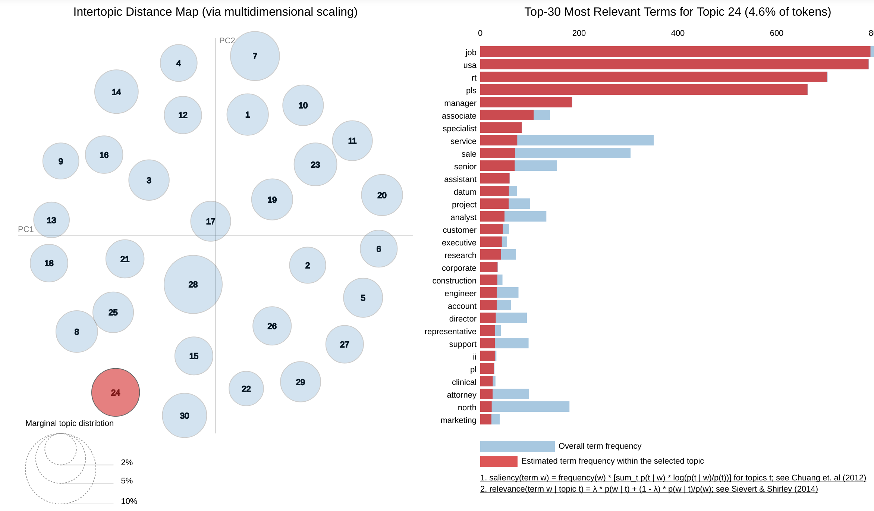
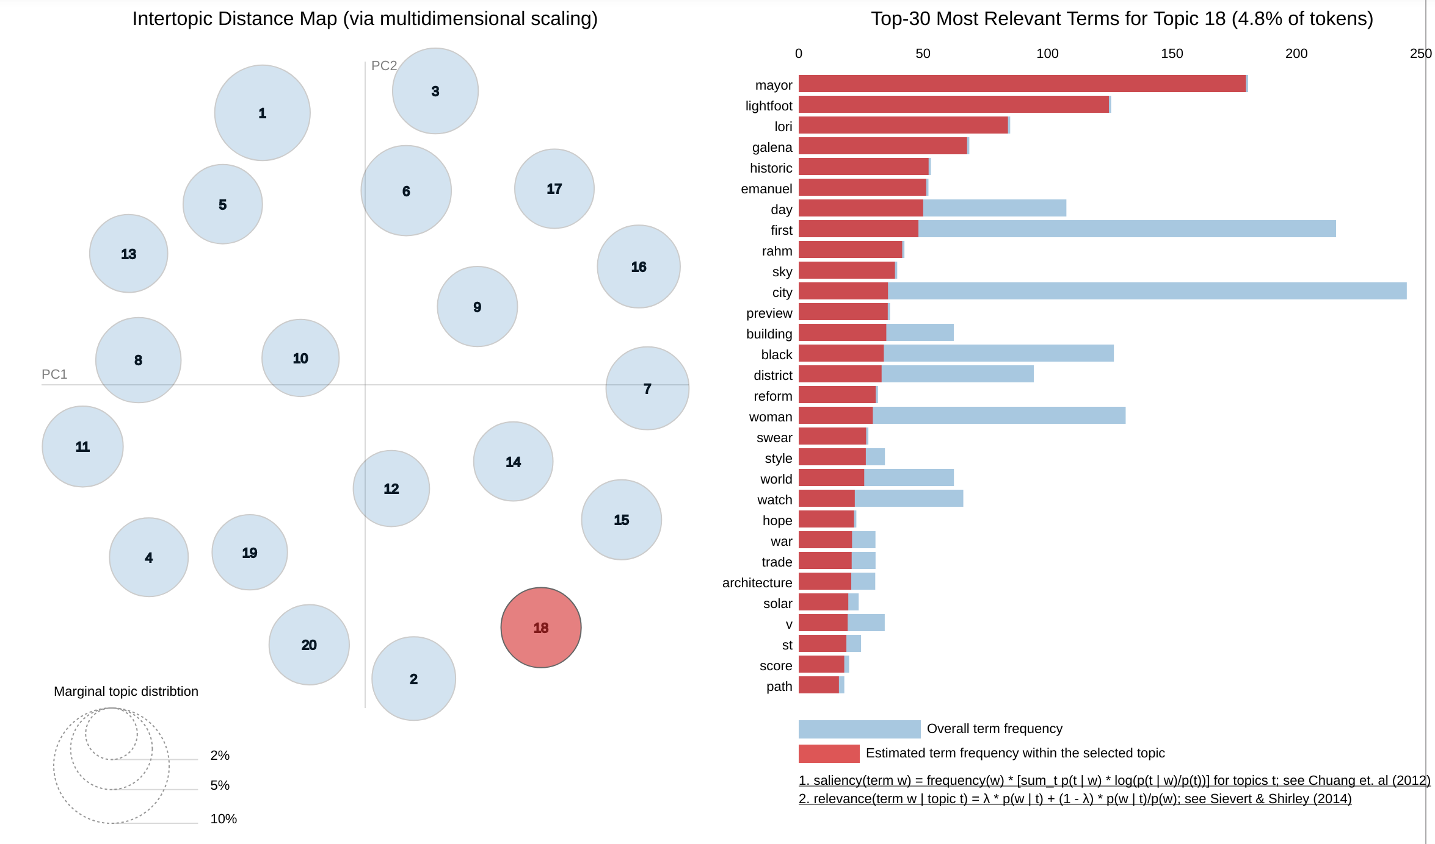
News Article Topic Detection
After multiple combinations and iterations of Topic Modeling with LDA and manual keyword inspections were performed, a few topics were identified, notably:
Topic related to sports
Topic related to weather
Topic related to entertainment (Movie, TV shows, festivals, actor/actress, etc.)
Topic related to home sales/rentals, flight promotions, ads
Topic related to job postings & news related to specific companies
The majority of these topics are not quite relevant to this analysis i.e. articles about TV shows, Chicago Bulls performance, or NYC-ORD flight promotion should not impact IL population growth. These topics are filtered out.
After filtering out topics that are considered irrelevant to the analysis, LDA was performed again. A clearer picture has been established with 20 topics post-filtering. These topics include:
Chicago mayoral election
Legislation on electric vehicle registration fee
State taxes initiatives
Marijuana legalization plan
Police-related affairs
Topic related to job postings extracted from LDA prior to filtering
Topic related to a new Chicago mayor election extracted from LDA after filtering

Slide 5
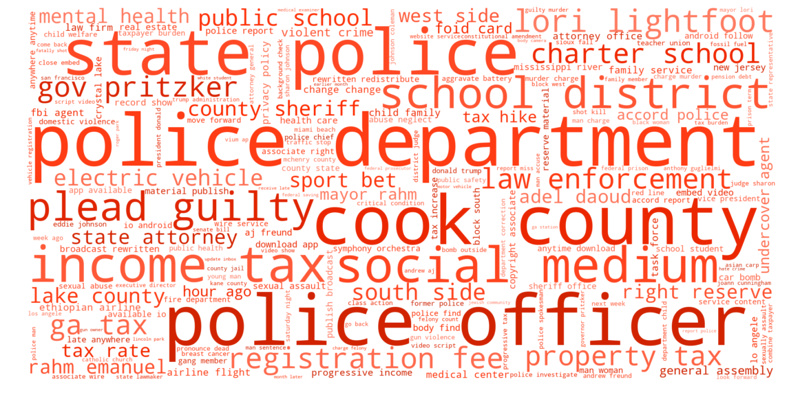
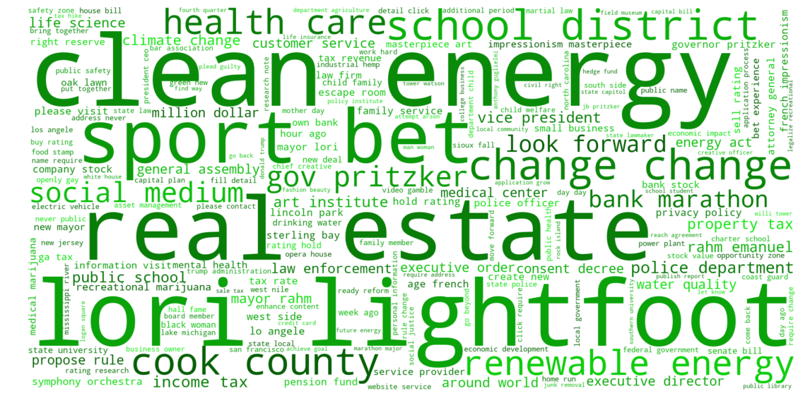
Sentiment Analysis
Custom sentiment lexicon (based on Vader) is leveraged to produce sentiments associated with the filtered news articles
Based on the sentiment analysis, the following inferences can be made regarding the status of IL population and businesses, notably:
Potential reasons for population decline
Taxation - Negative sentiment is observed for news articles related to property taxes, income taxes, taxes on electric vehicles, and general tax increases
Law Enforcement - Police & law enforcement are heavily associated with negative sentiment. While this could be biased due to the nature of news articles, it can be an indicator of the amount of crimes and violence in IL.
Potential reasons for people & businesses to be attracted to IL
Clean Energy - Positive sentiment is heavily associated with clean & renewable energy.
Recreational Policies on sports betting & rec. marijuana legalization make the list as well. Liberal recreational policies may potentially retain & attract more residents to IL.
Wordcloud for Overall Negative Sentiment
Wordcloud for Overall Positive Sentiment

Slide 6
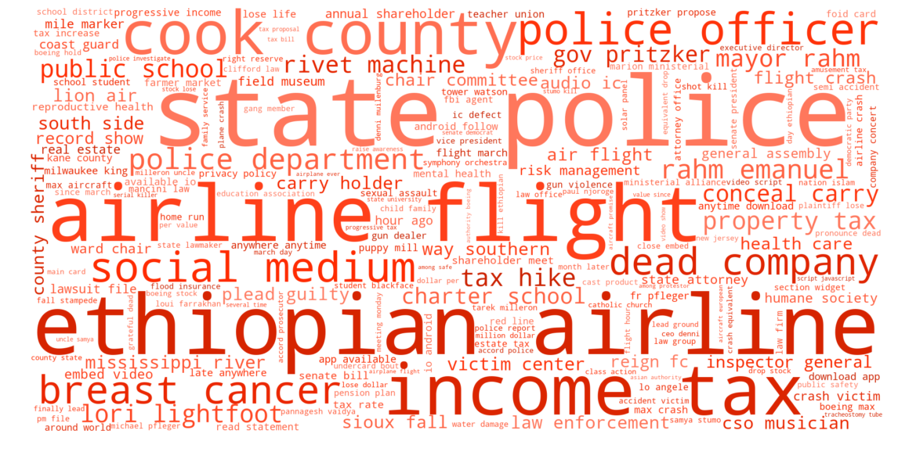
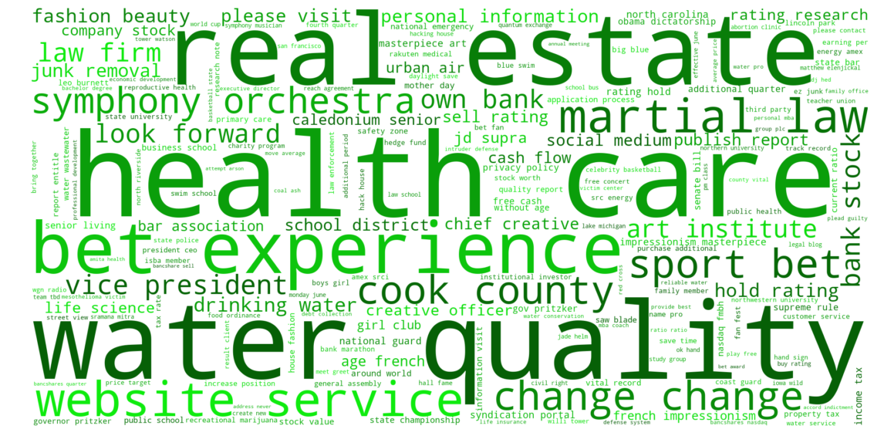
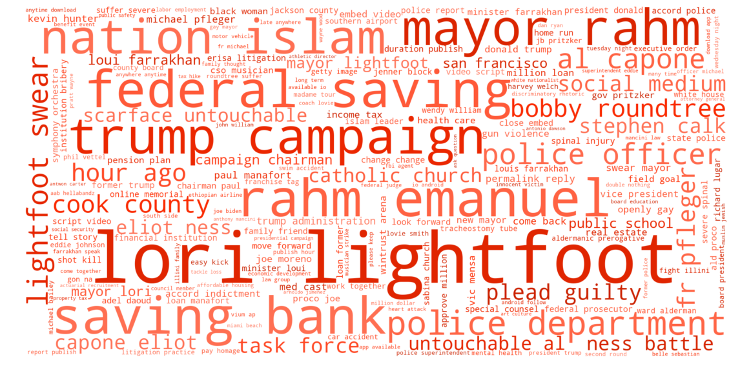
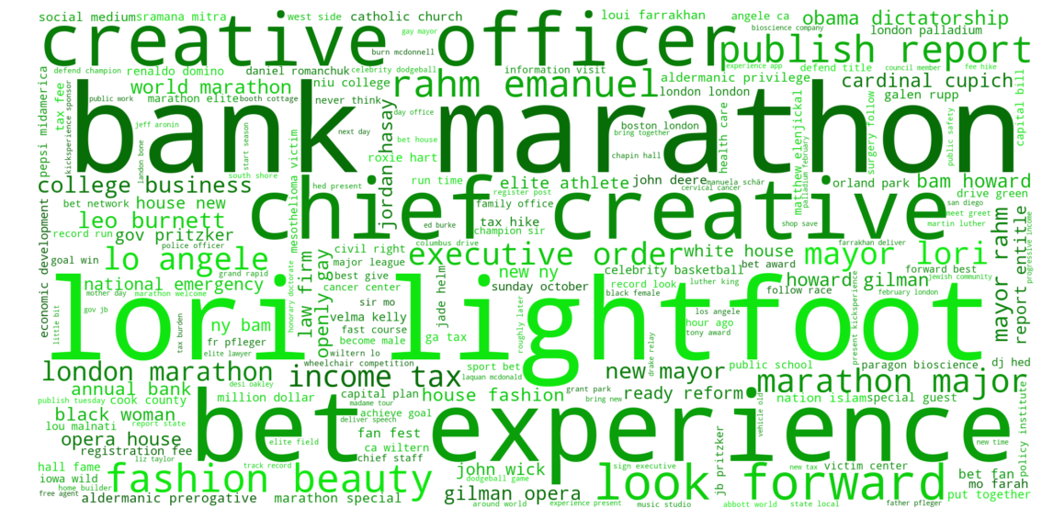
Targeted Sentiment Analysis
Named Entity Recognition (NER) extraction was performed using Stanford NLP NER Tagger to target articles specifically related to persons & organizations.
Business/Organization
Water Quality, Health Care, and Real Estate have been heavily associated with positive sentiment.
Upon further inspection, it is found that businesses & orgs in IL are taking multiple initiatives toward water quality improvement, health care promotion, and public housing expansion.
Topics of tax and law enforcement are still receiving negative sentiments
People
Unfortunately, not a lot of information can be derived from the sentiment analysis that would provide additional insight to IL population growth/decline.
It does however, recap the sentiment toward the Chicago mayoral election, in which Lori Lightfoot won the race.
Wordcloud for Business-focused Negative Sentiment
Wordcloud for Business-focused Positive Sentiment
Wordcloud for People-focused Negative Sentiment
Wordcloud for People-focused Positive Sentiment

Slide 7
Insights & Recommendations
Why should businesses stay in IL or move to IL?
Take advantage of upcoming laws & regulations
With the focus on clean energy production & recreational policies, there are multiple opportunities to expand business in the clean energy sector and the sports betting industry
Why should residents stay in IL or move to IL?
Focus on quality of life improvement
Businesses & orgs in IL are taking multiple initiatives toward water quality improvement, health care promotion, and real estate/public housing expansion
Liberal recreational policies
Recommendations to the State of Illinois
Take population growth & public sentiment into account when introducing changes in laws & regulations, especially on taxation, recreational policies, and healthcare
Sentiments on these topics are very strong, which could lead to population growth/decline. Tax hikes are heavily associated with negative sentiment, while recreational policies and healthcare are associated with positive sentiment.
Focus on Law Enforcement
Continue to focus on reducing crime rates and negative perceptions of law enforcement
Continue to promote clean energy consumption and production
e.g. tax credit/deduction for business/residents, subsidies for business in the clean energy sector.
Wordcloud for Overall Negative Sentiment
Wordcloud for Overall Positive Sentiment

